Slide 1
Inheritance
Code reuse, upgrade

Slide 2
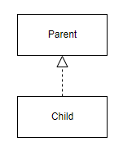
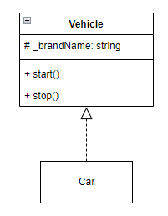
What is inheritance?
Child class inherits from Parent class
Attributes
Behaviors
Class Car inherits from class Vehicle
We can say a car IS-A vehicle
A car has all of a vehicle’s attributes
A car has all of a vehicle’s behaviors

Slide 3
Why do we need inheritance?
Reuse
Upgrade

Slide 4
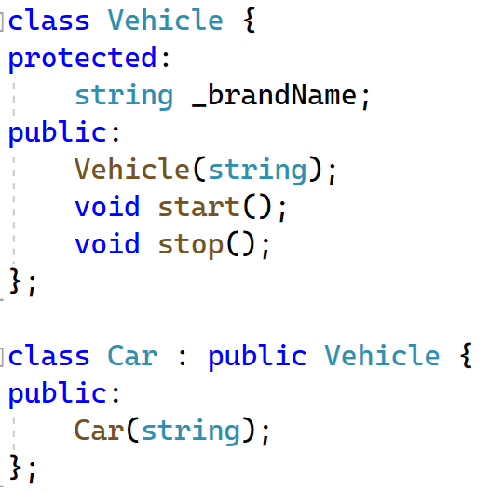
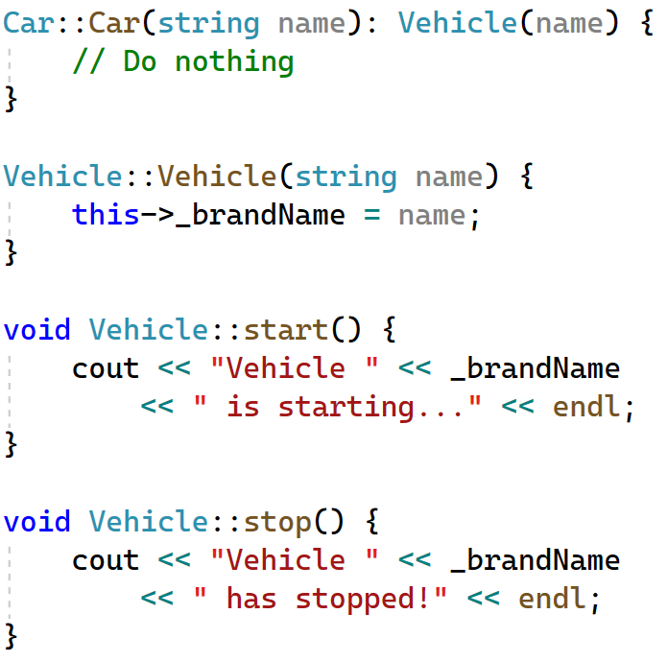
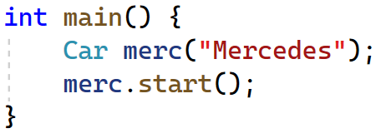
Let’s see some C++ code in action

Slide 5
Things to consider
In the design, class Car has no start function, how can we still call that function?
Which attributes can be accessed from class Car? Why?

Slide 6
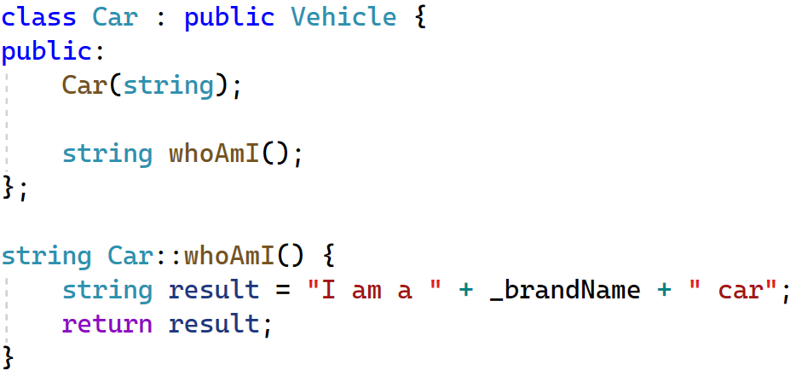
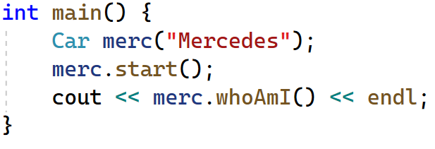

Accessing parent’s protected attributes
Why can we write this?

Slide 7

Order of creation & destruction
Constructor call order: from parent to child
Destructor call order: from child to parent

Slide 8
How about paramterized constructor?
A little bit tricky

Slide 9
Other terminologies
Parent class: base / super
Child class: derived / derivative / subclass

Slide 10
Strategy for later upgrade (version 1.0)
If your class might be inherited in the future, put all the attributes’ visibility to protected rather than private (of course not all of them, just reusable ones)

Slide 11
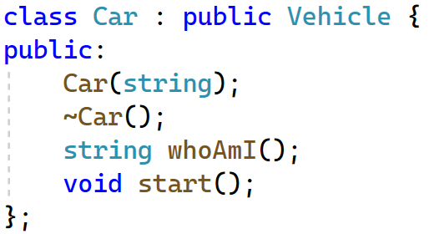
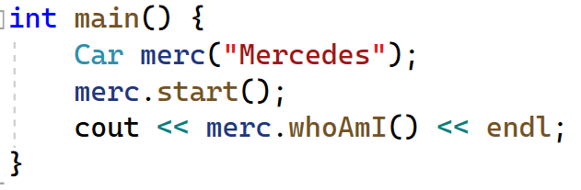
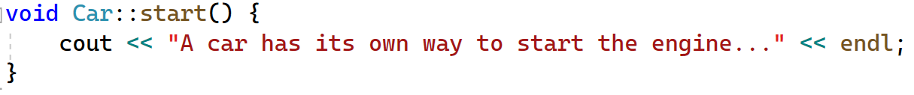

What if class Car also has its own function start?

Slide 12
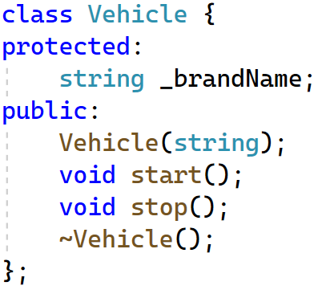
Shadowing parent’s behaviors
In this case, child class Car’s start() shadows the parent class’ start()

Slide 13




Shadowing

Slide 14
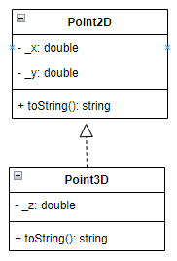
Exercise
Create class Point3D that inherits from class Point2D.
Shadow its parent’s string toString() function

Slide 15


Type compatibility

Slide 16
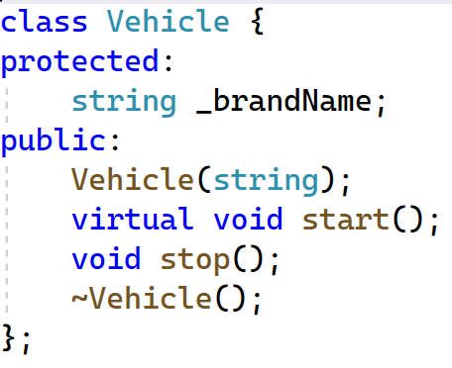
Forcing dynamic binding
Now the correct version of function start will be called!

Slide 17
How to do runtime resolution for polymorphism?
vtable: virtual table (table of function pointers), per class
vptr: pointer to vtable, per object
In constructor, set vptr of created object
7512
p1 = new Circle()
p1->area();
p1 vptr -> Circle vtable
7512
Circle vtable
+ 4724: area()
+ 4728: perimeter()
p2 = new Circle()
p2->area();
Square vtable
+ 5952: area()
+ 5956: perimeter()
p3 = new Square()
p3 vptr -> Square vtable
9916
p4 = new Circle()
9916

Slide 18
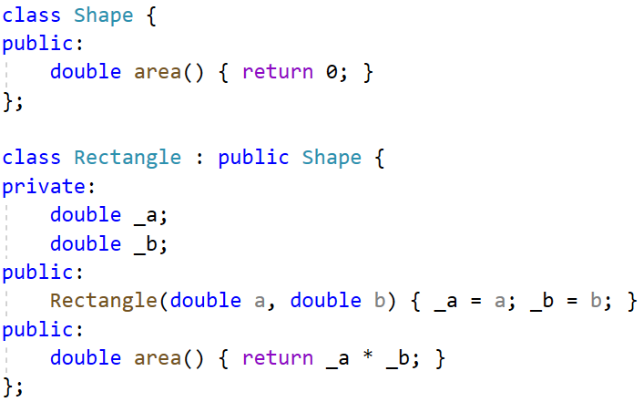

Exercise - Fix the problem of shapes calculating area

Slide 19
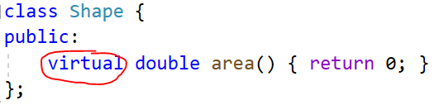
Answer - Adding virtual to force dynamic binding

Slide 20
Virtual destructor
We have a pointer here
Now we can call the start() function of class Car
But what happens if we delete? Will the destructor of class Car be called? NO
The solution is: virtual destructor

Slide 21
Strategy for future upgrade (version 2.0)
Members: protected
Functions that could be improved by child class: virtual
Destructor: virtual

Slide 22
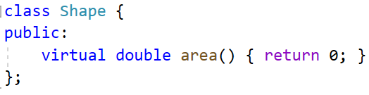
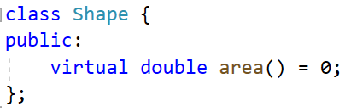
Pure virtual function & abstract class
Sometime we don’t know the implementation of the function, the child class will be responsible for that
Let’s turn our area() function into pure virtual function
abstract class
pure virtual function

Slide 23
Instantiating an abstract class
Cannot create a new instance of an abstract class!
Why? Because there is no implementation, therefore, no instance can be created!

Slide 24
When to use virtual function & pure virtual function?
+ Default implementation + No idea about implementation
+ Child class could use + Child class must implement
parent’s implementation its own
or implement its own

Slide 25
Example
Object class with toString default implementation
Virtual or pure virtual?

Slide 26
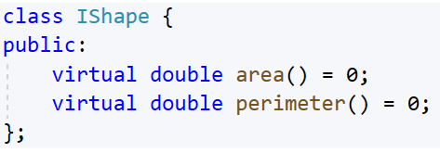
Interface / contract
Class that contains only pure virtual functions
Other name for interface class: contract
All child classes must conform to the contract!

Slide 27
Multiple inheritance

Slide 28
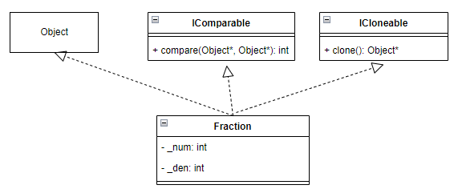
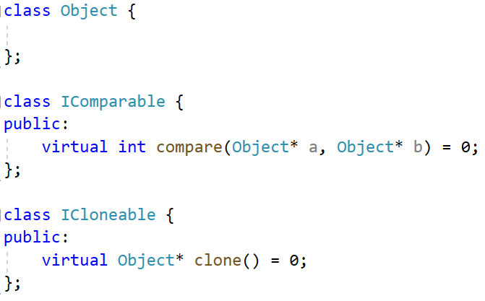
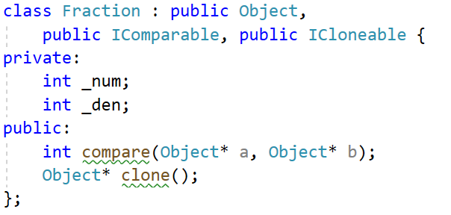
Multi classes inheritance

Slide 29
Exercise - Create class diagram (Analysis)
Exercise 01
Vehicle, Car, Bicycle, GasolineCar,
ElectricCar, HybridCar, Cabriolet, DieselCar
Exercise 02
ISwimable, IDiveable, IFlyable, IRunnable
Duck, Human, Fish, Dog, Cat

Slide 30
Things to consider
C++ allow multiple classes inheritance!
Many languages (C#, Java, Kotlin, Swift) don’t allow multiple classes inheritance, only single class inheritance
But they will allow multiple interfaces inheritance
Why?

Slide 31

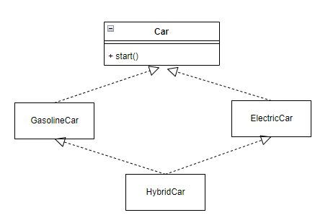
Diamond problem
start() is called through GasolineCar branch or ElectricCar branch?
Ambiguous

Slide 32

C++ diamond problem’s solution
Virtual inheritance

Slide 33

Other languages’ solution
Prevent it from happening in the beginning
DO NOT ALLOW MULTIPLE CLASSES INHERITANCE

Slide 34
Polymorphism

Slide 35
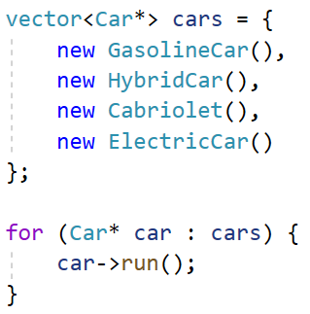
Polymorphism in short
Through inheritance, perform different tasks using the same method

Slide 36
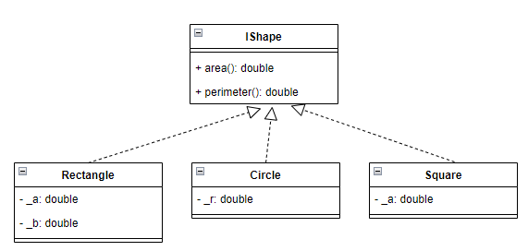
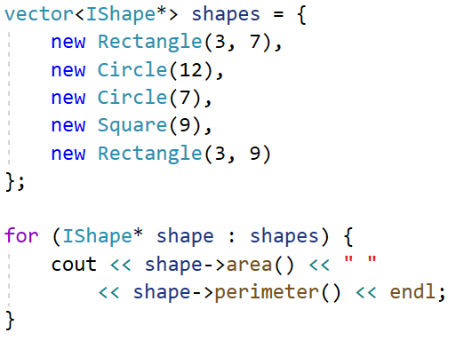
Exercise - Find area and perimeter of shapes

Slide 37
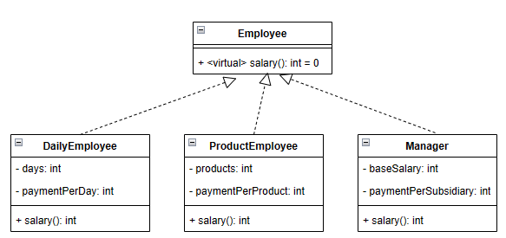
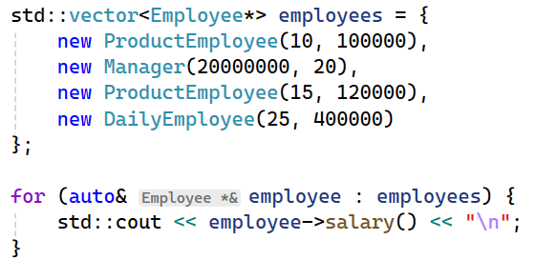
Exercise: Salary

Slide 38
The circle-ellipse / square-rectangle problem
https://en.wikipedia.org/wiki/Circle%E2%80%93ellipse_problem
Violation of the Liskov substitution principle, one of the SOLID principles
Objects usually modeled as subsets of each other (IS-A)
Circles: subset of Ellipses (Circle IS-A Ellipse)
Squares: subset of Rectangles (Square IS-A Rectangle)
Some mutator methods must be supported
StretchX in Ellipse must be supported in Circle (for example)
This will make a circle not a circle any more!!!

Slide 39
Solution to circle-ellipse / square-rectangle problem
Simplest solution is to use another class: IShape
Both Cirle & Ellipse will inherits from this class
Composition over inheritance

Slide 40
Other topics

Slide 41
Can struct do inheritance?
Yes

Slide 42
Struct vs Class
Struct is more lightweight
All attributes are public by default in struct
Vs All attributes are private by default in class

Slide 43
Read from materials
Name of class
Clone
Parse
Prototype
SOLID -> Inversion of control
Unit test

